Slide 1
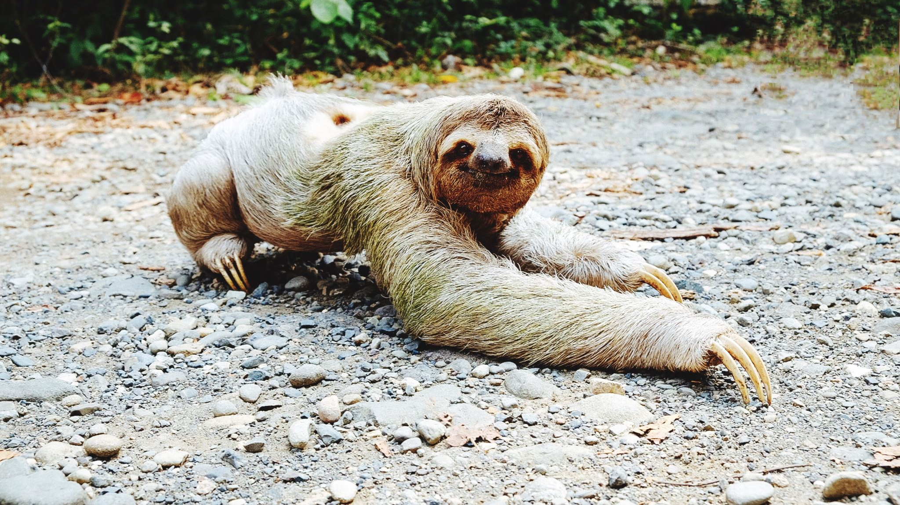
My Sloth
My Responsibility

Slide 2

My Sloth
What do I understand by sloth?
What do I want in my life?
Do I want sloth in my life?- If so- why? How does it help me?

Slide 3
My Sloth
What do I understand by success?
What does success mean to me?
In what areas of life do I truly want to succeed in and why?

Slide 4
My Sloth
How much time have I got left in this world?
What will tomorrow bring? Am I in control of tomorrow?
If I knew today would be my last day- how would I choose to spend it and why?
Would I prefer to choose to spend time enjoying myself, sharing moments with loved ones or helping those that I love and who need my help?

Slide 5
My Sloth
If I was on a boat with a sloth in the middle of an ocean and I thought that I was going to die - how would I choose to spend my last moments:
Eat the sloth? Hug the sloth? Kiss the sloth? Feed the sloth?
Pray for repentance? Pray to be rescued? To whom would I direct my prayer and why? Can the sloth save me?
Sleep?
Cry?
Sing? Read? Laugh?
Teach the sloth how to direct the sails?
Which would I see as less of a ‘waste of time’? And why?

Slide 6
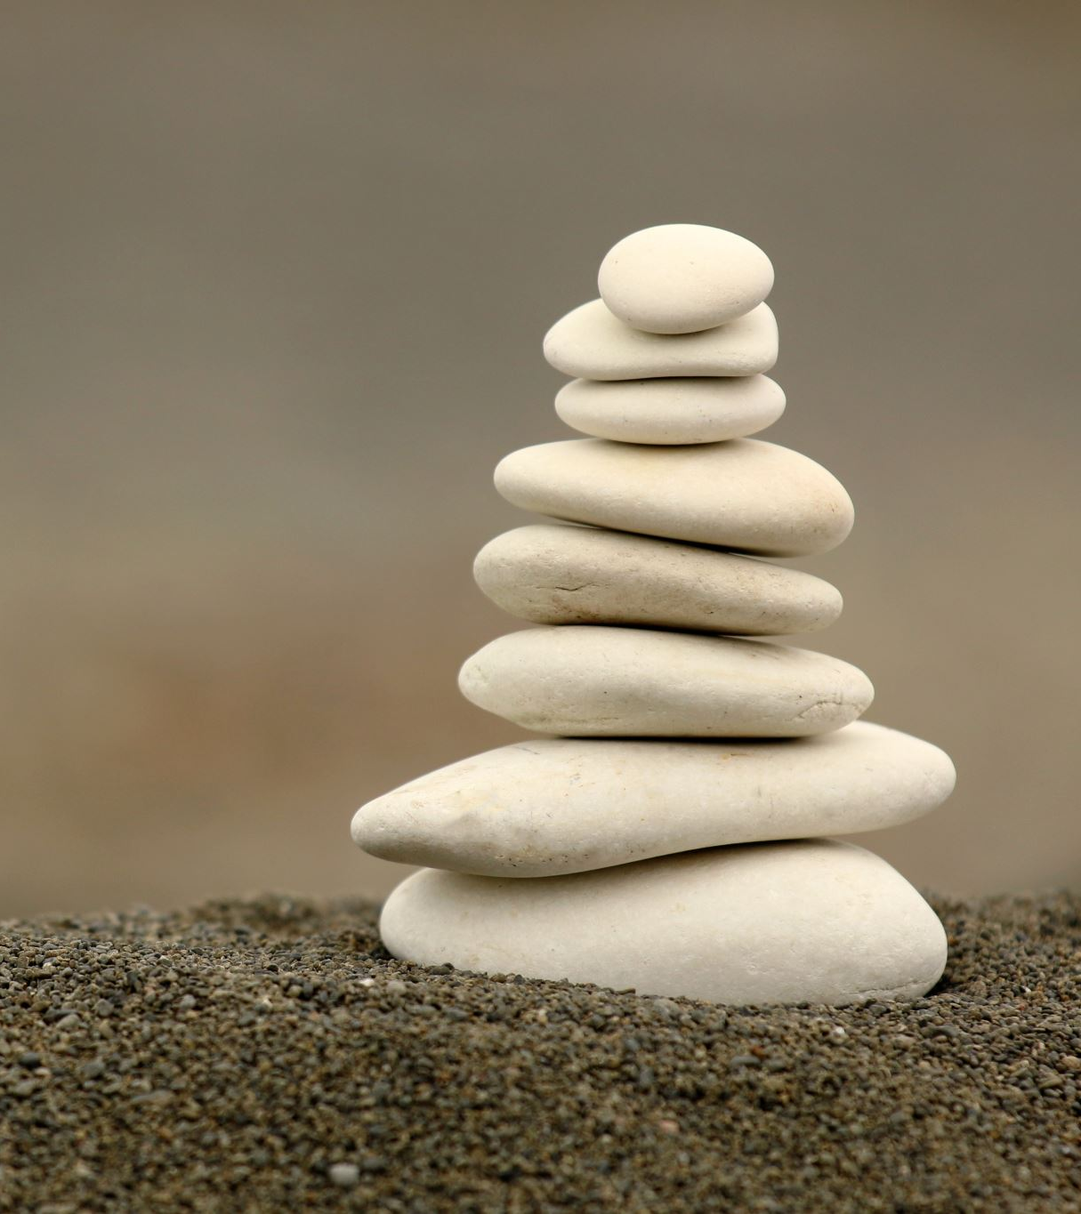
My Sloth
What do I understand as ‘wealthy?’
What is more important to me- my physical wealth or my spiritual wisdom?
What do I understand as ‘healthy?’
What is more important to me- my physical health or spiritual health?- and why?

Slide 7
My Sloth
Who am I? Why am I here? Who is everyone else?
Who do I want to be? Who do others want me to be?
Who do I want to become? Who do others want me to become?
What really matters to me? Does it matter to me what others think? If so- why?
Do I know the answer to any of these questions?
If I knew the answer- how would this affect how and where I choose to put my efforts in life?

Slide 8
My Sloth
Am I a thinker? How does thinking harm me and others?
Am I a feeler? How does feeling emotion harm me and others?
Am I a speaker? How does speaking harm me and others?
Am I a doer? How does ‘doing’ harm me and others?
Which one of these has most potential in helping myself? And why?
Which one of these has most potential in helping others? And why?

Slide 9
My Sloth
Do keep my promises? If not- how does this affect the respect I have for myself? How does this affect how much I trust myself and others? How does this affect my Sloth?
Do I expect others to keep their promises to me?
Do I like to ’obey’ the rules of my society? – If not- how do I choose which rules to obey and which to break? Do I choose according to what suits me best? How does this affect how I feel about myself? How does my behavior impact how others feel about me? How does this affect my society?

Slide 10
My Sloth
Would I prefer to serve or be served?- why?
Would I prefer to be a leader or a follower? Why? Who am I leading? Am I able to lead myself? Who am I following? How do I know that they are rightly guided?
Do I have any true preference for anything? Or do I just accept whatever is given to me?
Do I ask enough questions? Do I ask too many questions?
How do I know if I am guided?
Am I more important than anyone else? If not- then why do some have more than others when others work harder than some? If I am more important- how am I more deserving of what I have compared to others who have less?

Slide 11
My Sloth
Am I blessed? What am I grateful for?
What are my strengths? What makes them strengths? Do I do them justice?
What are my weaknesses? What makes them weaknesses? Do I do them justice?
Do my possessions truly belong to me? Or do I have them on loan?
Do my talents belong to me? Where are they from? What am I supposed to do with them?
Am I grateful for my possessions and my talents? How would I feel without them?
How can I show more gratitude for my blessings?
To Whom should I direct my gratitude and why?

Slide 12
My Sloth
What gives me more joy:
Serving or being served? Is this in my control?
Expressing gratitude or receiving gratitude? Is this in my control?
The emotion of passing judgement on others or feeling judged by others? Is this in my control?
Expressing my love or feeling loved? Is this in my control?
Being a giver of kindness or receiver of kindness? Is this in my control?
Working more so others can work less, or others working more so I can work less? Is this is in my control?
Sacrificing for others, or others sacrificing for me? Is this in my control?
Showing respect to others, or others showing respect to me? Is this in my control?
Telling the truth, or being told the truth to? Is this in my control?

Slide 13
My Sloth
Which of the following bring me more joy? If not joyful, which am I more likely to choose?
Lie myself, or be lied to?
Be rich but greedy or poor but kind?
Work hard to give more, or work less to give less?
Work more to receive more for me, or work less to receive less for me?
Work less than others and receive less for me, or work less than others and receive more for me?- why?
Take from others so I have more for myself, or deal justly with others but have less for myself? Why?
Steal something or be stolen from?
Call someone a nickname or be called a nickname by someone else?
Disobey the rules, or be disobeyed?
Cheating on a partner, or a partner cheating on me?
Murder someone or allow myself to be murdered?

Slide 14
My Sloth
What do I understand by love?
Who or what things do I love in my life? And why?
Is what I love more physical or spiritual?
What do I understand by ‘unconditional love’?

Slide 15
My Sloth
What is the difference between lust and love?
Do I truly love those who I think I love?
Is my success and what I strive for dependent on how much I ‘love’ it?
Do I strive for what I love in order to benefit myself or others?

Slide 16
My Sloth
How much effort do I put into striving to succeed in attaining that which I love?- Can I think of any examples?
Have I ever spent time and effort chasing something which I thought I loved, only to find that when I got it, the feeling faded? Were my efforts wasted? Where did I go wrong? So what’s the point of chasing delusions? What’s the point in making effort for anything that is not real? Is it my efforts that were not worthy, or was it that which I was chasing? How can I better my judgement on what is worthy and not worthy in putting my efforts into? Why waste my time?
Have I ever achieved something that I needed or wanted in my life, without effort? If so- what was it- and how did I achieve it?

Slide 17
My Sloth
Do I wish that I could have anything I need or want without any effort?
Do I believe this will make me feel happy? if not- why not? if so- do I believe this happiness is everlasting? Why does it end?
Do I believe in an afterlife? What do I want to leave for my loved ones when I die?
What is more important to me- wisdom or gold? And why? Which one would I rather leave for my decendents when I die?
Can I take my achievements with me wherever I go into the afterlife? Does this depend on how I choose to invest my time and efforts?

Slide 18
My Sloth
Do I enjoy the challenge of a new project in life? How does it make me feel about myself? Once I have reached my goals, have I obtained an enduring peace and happiness or do I feel the need to have a new project?
Is there any area of my life that I can say has been successful that has brought me lasting joy, inner peace and love? What was it? What makes the feeling last?

Slide 19
My Sloth
Do I care about what others think about me? If so – why? Am I more concerned about what others think about me than what I think about myself? How does this make me feel about myself? Am I being true to myself?
How does caring so much about what others think of me direct my sails when it comes choosing what to put time and effort into?
If I was on a boat with an animal of my liking- would I let the animal direct my sails? If not- why not? How can my sloth be compared to an animal?
Can I re-adjust my sails to help me get to my desired destination?

Slide 20
My Sloth
Do I ever work so hard at pleasing others that I lose my identity of self?
Can I make everyone happy at the same time ,all the time? If not- why do I think this is so?
Do I ever portray an image of myself to others that is not really who I am or who I want to be?
How does this affect my anxiety levels? How does it affect my mood and level of enjoyment in life?
How does this affect my energy levels? How does this affect my desire to put in more effort in striving to succeed? Do I think this may have something to do with the reason I feel down and depressed at times?

Slide 21
My Sloth
Do I believe in a Being Higher than myself?
Do I believe in a Creator Who Knows my innermost thoughts and feelings?- If so- how much do I care about what He thinks of me?
Do I care more about what others think of me or what my Creator thinks of me?
Does believing in a Creator give me a better sense of purpose and meaning in my life?
Do I serve my Creator? Or do I expect my Creator to serve me? Am I happy with whatever He gives me, whether I perceive it to be good or bad~? Is my sloth level dependent on what am I given? If so – how and why?

Slide 22
My Sloth
How does belief in a Higher Being who knows my innermost thoughts and feelings affect my desire to endure the hardships and challenges that I face?
How does it affect my desire to want to stay true my beliefs?
How does my belief in a Higher Being affect how I understand true ‘success?’
What do I think I need to do more of, in order to stay true to what I believe?
How does this affect my energy levels and my desire to strive to succeed?

Slide 23
My Sloth
Do I prefer to be alone or part of a team?
Do I prefer to share my joy of success with others or take credit for it all myself?
Do I prefer to share my failure with others or am I willing to take all the responsibility myself?
Do I prefer to be separate or united with others? And Why?

Slide 24
My Sloth
Am I part of a team in my family?
Am I part of a team in my relationship?
Am I part of a team at work?
Am I part of a team in humanity?
Am I part of a team in every interaction I have with another person or do I see myself as ‘separate?’
Am I a good ‘team player?’ and why do I think this is so?

Slide 25
My Sloth
Do I ever feel overwhelmed by all of the challenges in my life? Do I feel like I am constantly juggling many challenges at the same time? Do I feel like I am overburdened and close to burning out? How does this affect my energy levels and my sloth?
Am I the only one who faces hardship and challenges in life?
How do I know that my challenges are worse than anyone else’s?

Slide 26
My Sloth
Am I traumatized by my past so that I find it controls my thoughts and emotions and gives me little time to spend on anything that might help me or others in the present and future? Do I feel that my past controls me? How does it affect my sloth?
Do I feel that my life should have been much better than it is? Am I more deserving of happiness and joy than anyone else?- if so- what makes me more deserving? How does this thought and feeling about my life affect my sloth?

Slide 27
My Sloth
Do I find it difficult to forgive others who have hurt me and caused me ‘loss’ in my life? How does this affect my energy levels? How does it make me feel about myself? How does it affect my desire and will to help people? How does it affect my sloth?

Slide 28
My Sloth
Do others misunderstand me? Do I feel Judged by others? Do I feel lonely? How does this affect my sloth?
How do my ‘failed’ attempts at kindness make me feel about myself? Why do I believe that I ‘failed’ in these attempts? Do I believe that what I do to help others- makes any positive difference to their lives? Does it matter to me if they themselves do not openly realise it? Why?

Slide 29
My Sloth
Do I feel unloved and unwanted by others? Do I feel that no one truly loves me the way that I want or need them to love me? How does this affect my sloth levels?
Do I wish that I could be ‘saved’ miraculously right now by someone who loves me who walks through the door and give me everything I ever wanted or needed? Do I deserve this? Why Do I deserve it? How can I deserve it even more?
Have I got any more to give?

Slide 30
My Sloth
Do I feel respected by others? How do I feel when I put lots of effort into something I believe to be positive and helpful, only to be treated with disrespect in return by others? How does this affect my desire to want to continue helping that person?

Slide 31
My Sloth
When I help people- do they show me enough gratitude? Do I believe I give more than I get back from others? How does this affect my desire and energy levels when it comes to helping people who need or want my help?
Do I give to recieve or do I give without expectation in return? How can I learn to give without expectation? Do I truly know the meaning of unconditional Love?

Slide 32
My Sloth
Do I ever ask myself the following questions….?
‘Have I not sacrificed enough already?’ ‘Perhaps I can start my diet tomorrow?’
‘Perhaps I can start my charity tomorrow?’
‘Perhaps I should start my exercise regime tomorrow?’
‘Perhaps I can clean my dirty house tomorrow instead..?’
‘The more I give the more I lose out for myself.. If others are lazy, why shouldn’t I be as well?’
‘Should I not put less effort into work and helping others so that I can have fun and enjoy myself more?’
‘How can I alone make a difference to world poverty? Is there any point helping anyone when so many are suffering?’

Slide 33
My Sloth
What do I understand by ‘balancing my life’ ? Do I have a good balance in life? Am I well balanced?
How do I feel I could get a better balance and why?
Is there any effort I need to put into this in order to get a better balance?

Slide 34
My Sloth
How did it make me feel to have achieved what I have strived for so far in my life? How did this feeling affect my speech and behaviour towards others? Did this feeling last? If not- why do I think it did not last? What could have made this feeling last longer?

Slide 35
My Sloth
Have I ever put so much effort into something that I wanted to achieve but never been able to achieve it? How did this make me feel about myself? Did I feel like a ‘failure’?
How did this affect my desire to put effort into other potential achievements?
What do I think obstructed my ability to achieve what I did not achieve despite my efforts? What did I learn from this experience?
How did it affect my ability to ‘empathise’ with others who are facing similar hardships?
Could I perhaps change the way I perceive this experience into a ‘success’ by changing my understanding about that what I believe to be ‘success’? What if success could be achieved from my failure through learning more about empathy?
Perhaps the empathy or other wisdom I have learnt from my failure, can help others to succeed? How would this make me feel about myself?
Is my success the success of others?

Slide 36
My Sloth
How does my anger affect my sloth? Can I think of an example?
How does my greed affect my sloth? Can I think of an example?
How does my gluttony affect my sloth?
How does my envy affect my sloth? Can I think of an example?
How does my lust affect my sloth? Can I think of an example?
How does my Ego/pride affect my sloth? Can I think of an example?
How do my ‘fears’ affect my sloth? Can I think of an example?

Slide 37
My Sloth
How does my lack of patience affect my sloth? Can I think of an example?
How does my lack of endurance affect my sloth? Can I think of an example?
How does alcohol affect my sloth? Can I think of an example?
How does gambling affect my sloth? Can I think of an example?
How does gossiping and backbiting affect my sloth? Can I think of an example?
How does witch-craft/black magic/fortune telling affect my sloth? Can I think of any examples?
How does belief in my ‘self-sustenance’ affect my level of sloth?
How does my judgement of others affect my sloth?
How does my lack of forgiveness of others and of myself affect my sloth?

Slide 38
My Sloth
How does my sloth affect my own wellbeing? Can I think of any examples?
How does my sloth affect the wellbeing of others? Can I think of any examples?
How does my sloth affect my thoughts?
How does my sloth affect my emotions?
How does my sloth affect the way I speak to others?
How does my sloth affect the way I behave?
Does my sloth cause harm to anyone other than myself? Can I think of any examples?

Slide 39
My Sloth
Is there any good that came out of my hardships in life? Can I think of any examples?
Do I learn more from times of hardship or times of ease? How does this make me feel about myself? How does this affect the way I perceive ‘hardship?, ‘failure’ and ‘success’?
If I could see all challenges as ‘opportunities’ to learn and grow instead of opportunities to fail and feel down about myself, would I have less fear in facing future challenges?
How would this change of mentality affect my energy levels, level of ‘fear’ and level of sloth towards those challenges?

Slide 40
My Sloth
Am I a victim or can I take more responsibility?
Do I choose to put either more or less effort into life, or am I forced to do this?
Do I feel like my life is tasked beyond my capacity?
Am I grateful enough? Do I want to express my gratitude more? How can I show more gratitude for my blessings?
Am I in control of my health and wealth? Why should I have it more than someone else? Can I stop myself from losing it? What can stop it from being taken from me if I don’t deserve it? How can I use it in a way that helps others? How does my sloth get in the way of this?

Slide 41
My relationship with my sloth
Do I have control over my sloth or does my sloth control me?
What does my sloth tell me to do? Do I believe it is telling me truth?
What does my sloth tell me not to do?
Am I worshipping my sloth by listening to it? Is it worthy of worship? Who owns the choice? – Myself or my sloth?

Slide 42
The Sloth of others
How do I know that ‘sloth’ in others is truly ‘sloth?’
How does the sloth of others affect me and why? How does it affect my health and well being?
What impact does the sloth of others have on health and well-being of others? Can I think of any examples?
How does the sloth of others affect those that I love?
What impact does the sloth of those I live with have on others in the home?
What impact does the sloth of those at work have with others at the workplace?
Could I be misjudging people as ‘lazy’ and doing them injustice? Perhaps they have good excuses for their sloth? Do I need to be more understanding? Am I too quick to judge?

Slide 43
The Sloth of Others
How do I feel when others ‘break the rules’? How does this impact me?
How do I feel when others break their promises to me? How does this affect my tust for others? How does this affect our relationship?
Do I feel that others should put more effort into practicing what they preach?
Do I wish that others would do what they say more?
Do I feel let down by others? Do I let myself down in the same way?

Slide 44
The Sloth of Others
What character traits am I attracted to in another individual? Do I find ‘sloth’ in others attractive? If not- why not? If so- why do I find sloth attractive?
Do I expect others to put more into a relationship than I am willing to do myself? Or am I willing to put either the same or more than the other? Why? How does sloth affect the dynamics of the relationship? Can I think of any examples?
How do I feel when my husband/wife/partner does not seem to be putting much effort into our relationship? How does it make me feel about myself? How does it make me feel towards my partner? How does it affect our relationship? Do I listen to their needs? Have I tried to understand what I perceive to be ‘sloth?’ Could it be that I am misjudging the situation?

Slide 45
The Sloth of Others
What makes a team work well together?
What makes others ‘good team players’ and why?
What makes it more likely that a team will succeed in a project/game/achievement?
What potential harm can the sloth of others bring to my team work? How does this affect how I feel towards others? How does this affect my own desire to put in effort into team work?

Slide 46
The Sloth of Others
How do I feel when I see others are not putting as much effort in as I might want them to? How does this affect the other members of the team?
Can I think of an example where another team member has let the team down due to what others assumed to be lack of effort?? What happened? How did his speech or behavior affect the rest of the team? How did his actions affect the project outcome?
Could it be that perhaps there was a good reason for why the member of the team did not put more effort into the game? How do I think it made the individual feel when he or she became aware that others felt let down by him or her?

Slide 47
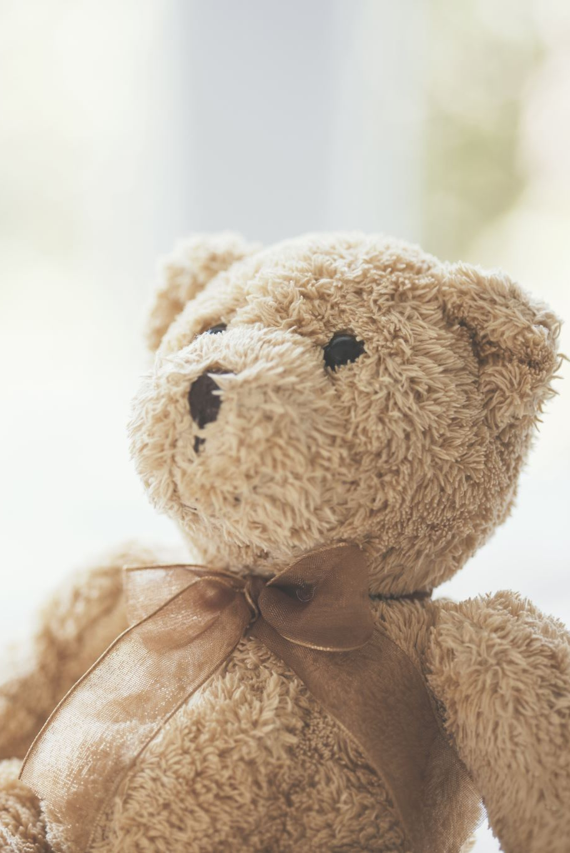
The Sloth of Others
What sacrifices did my parents makes for me? How did this make me feel about myself and towards them?
Did my mother feed me when I was hungry? Did my father give me time?
Did my parents show me respect and love and kindness and guidance? Did my parents encourage me to always try my best in life and in helping others? If not- how did this affect my sloth? Are my parents to blame for my sloth? Do I need to take more responsibility?
Was I a ‘good child?’ for my parents? Did/do I show my parents gratitude, respect and love for all that they did/do for me?
Does my sloth affect the relationship I have with my parents?

Slide 48
The Sloth of Others
What makes a ‘good parent’ from my own understanding? Am I a good parent? Do I try my best with my child/ren?
Do I want to improve my relationship with my child?- if so in what way?
What is more important? My happiness and wellbeing, or that of my child?
Are there any areas I could work on to be a better parent for my child/ren? Am I able and willing to put in this effort? Do I expect anything in return?
Am I willing to sacrifice for my child/ren?
Do I expect my child/ren to sacrifice for me?
Do I want or need forgiveness from my children for the areas that they may have believed that I ‘failed’ as a parent? Or do I hope that one day they will understand more from ‘my’ perspective?

Slide 49
The Sloth of Others
Will my effort to be a better parent involve me having to make sacrifices? If so what? Am I willing to make these sacrifices?
What ‘success’ do I want for my child/ren? Do I see their success as that of my own?
Do I want my child/ren to reach their best potentials in life? What can I do more to inspire them to try their best in life? Can I be a better role model for them?
How does my sloth affect the way I behave with my child/ren? What impact may it have on the sloth of my children?
How does the ‘sloth’ of my child affect our relationship?
How does it make me feel when my child shows me gratitude, respect and love? How if at all does this affect my behaviour towards my child?
What makes me less likely to ‘forgive’ the faults of my child/ren? Is there anything too bad that I would not forgive?
Do I want or expect my child/ren to make more effort in out relationship?
Do I feel loved by my child? If not- what would make me feel more loved? Is there anything I could have done better as a parent?
Could I have put in more effort to be a better parent for my child? How did/does sloth affect the relationship that I have with my child/ren?

Slide 50
My Relationship with the sloth of others
Am I able to control the sloth of others, or am I more likely to gain control over my own sloth?
Do I have a right to try to control the sloth of others?
How much do I allow the sloth of others affect my own sloth?
Do I have control over my sloth? Do I want to have control over my sloth?
If I gained control over my sloth- is it possible that I may be able to inspire others to do the same?

Slide 51
How does my sloth cause myself and others harm?
How does my sloth cause harm to:
My Physical Wellbeing?
My Spiritual Wellbeing?
My Mental Wellbeing?
My Emotional Wellbeing?
My Relationship with my partner?
My Relationship with my parents?
My Relationship with my child/ren?
My Relationship with work collegues?
My Success in fulfilling my life purpose?

Slide 52
How does my sloth cause myself and others harm?
Do I believe in a Higher Being? If so:
How has my sloth affected the relationship I had with my Creator?
How does my sloth affect the relationship I have with my Creator?
How does my sloth affect the potential future relationship I can have with my Creator?
How does my sloth affect my ability to fulfil any purpose in Life? How does it affect my ability to fulfil the Will of My Creator in this world?

Slide 53
How can my sloth help me?
Is there anything I can learn from my sloth of my past, that can help to improve my relationship with my Creator, and with others?
Is there any wisdom I can gain through reflecting on the negative effects of my sloth on my relationships, that can help me to change my perspective on meaning of ‘success?’
Am I able to reflect on my past and see how struggle and hardship can be an opportunity to help both myself and others to grow?

Slide 54
How can I transform My Sloth
Am I able to transform my past ‘failings’ associated with my sloth, into ‘success’- by gaining wisdom and understanding from my mistakes through self reflection, taking responsibility and incorporating that wisdom into my present and future relationships?
Am I willing to make more excuses for the sloth of others, and not let the lack of effort from others affect my efforts?
Am I willing to let go of trying to blame and control others, and instead concentrate on working on myself so that I can inspire?
Am I willing to give to others without expecting anything back in return?
Am I willing to work on my envy, lust, greed, ego, gluttony, anger, and my fears in order to help me battle with my sloth and to take control of it?
Am I willing not to let belief in ‘fate’ allow me to become passive when it comes to trying my best with the blessings that I have to help others?
Am I ready to avoid anything that makes me more likely to allow my sloth to control me? Eg Alcohol? Gambling? Gossipping? Backbiting? Bl;ackmagic/witchcraft/fortune telling?
Am I willing to work on my self discipline, patience and perseverance?? While accepting that I might slip at times, due to my human nature?

Slide 55
Transforming my sloth into patience and endurance
Am I ready to seek Truth with an open heart mind and soul?
Am I willing to ‘surrender’ to a path of ‘Truth’ and try my best to lead an honest, and ‘just’ life in loving kindness?
Am I ready to forgive and pardon the faults of others?
Am I ready to repent? Am I ready to believe in my worthiness to be forgiven?
Am I willing to work on my patience?
Am I ready to accept hardship and struggle, and persevere despite challenging times ahead?
Am I ready to let go of the need to ‘control’ others, and take control over the evil inclinations of my heart? Am I ready to let go of the need to change my past, or control my future and simply ‘surrender’ to the Higher Purpose of the Will of My Creator?
Am I ready to sacrifice in order to help others? Am I ready to sacrifice the physical and temporary, for the spiritual and everlasting Love?
Am I ready to Unite with others in Faith, compassion, patience, perseverance and acts of loving kindness? Am I ready to play my part?

Slide 56
Can I try…
Seeking refuge in The Creator from my sloth when it approaches me..
Regular prayer/meditation with self discipline?
Fasting
Acts of charity/loving kindness
Self reflection and use of empathy to gain better understanding
Listening more to others, being less judgemental
Using my blessings in any way I can to help others

Slide 57
So much to do, and so little time?!
Where do I start?
Imagine being on that Boat alone with your sloth

